Slide 1
Cationic Surfactant Adsorption on Natural Carbonate Mineral
Leyu Cui, Kun Ma and George J. Hirasaki
Sponsored by The Petroleum Institute/ADNOC
Rice University

Slide 2
Outline
Materials: Surfactants and Minerals
Adsorption on natural and synthetic minerals
Salinity influence on adsorption

Slide 3
Outline
Materials: Surfactants and Minerals
Adsorption on natural and synthetic minerals
Salinity influence on adsorption

Slide 4
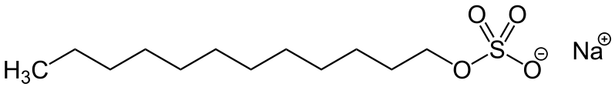
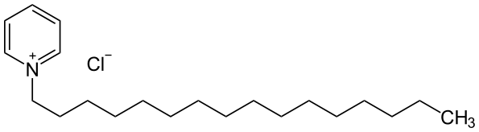

Surfactants
SDS (anionic): sodium dodecyl sulfate (CH₃(CH₂)₁₁OSO₃Na), 288.38 g/mol, ≥99.0%, Sigma-Aldrich.
CPC (cationic): hexadecylpyridinium chloride monohydrate (C₂₁H₃₈ClN · H₂O), 358.00 g/mol, 99.0-102.0%, Sigma-Aldrich.
Ethomeen C12 (cationic): ethoxylated amine from AKZO NOBEL Co. C12’s molecular weight is 288 g/mol.
R = Coco group (≈ 8 to 16 carbon)
x =y=1

Slide 5
Minerals
Dolomite: from Carl Pool Co. 200+ mesh. The BET surface area is 0.97 m²/g.
Limestone: from Franklin Minerals. 20/40 mesh. The BET surface area is 0.29 m²/g
Calcite: from Alfa Aesar Company. The BET surface area is 1.67 m²/g.
US Silica: from US silica Min-U-Sil-10. Surface area is 1.16 m²/g.
Kaolin: from Sigma-Aldrich. Surface area is 26.61 m²/g.

Slide 6
Outline
Materials: Surfactant and Minerals
Adsorption on natural and synthetic minerals
Salinity influence on adsorption

Slide 7
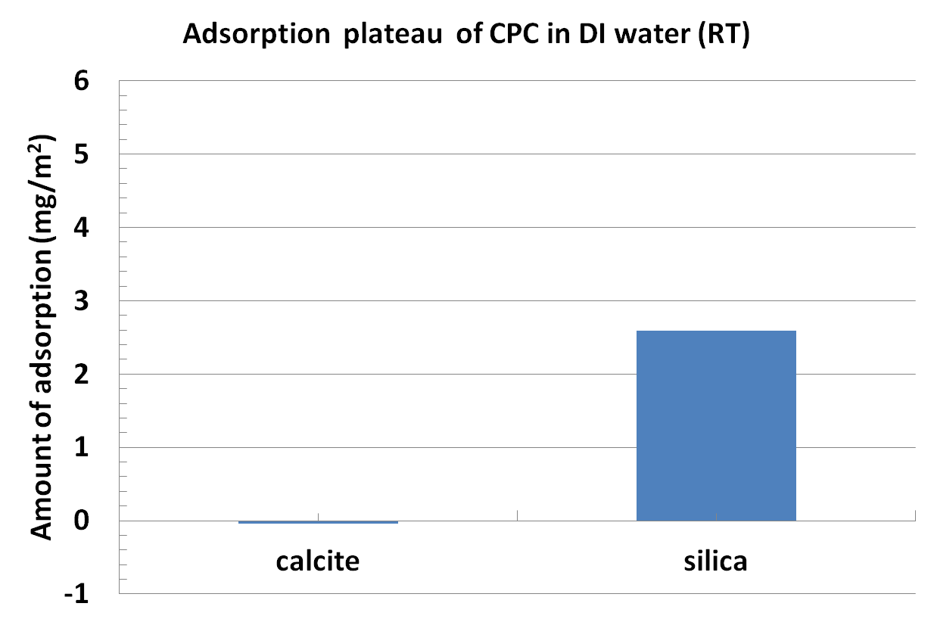
Adsorption of CPC on calcite and silica

Slide 8
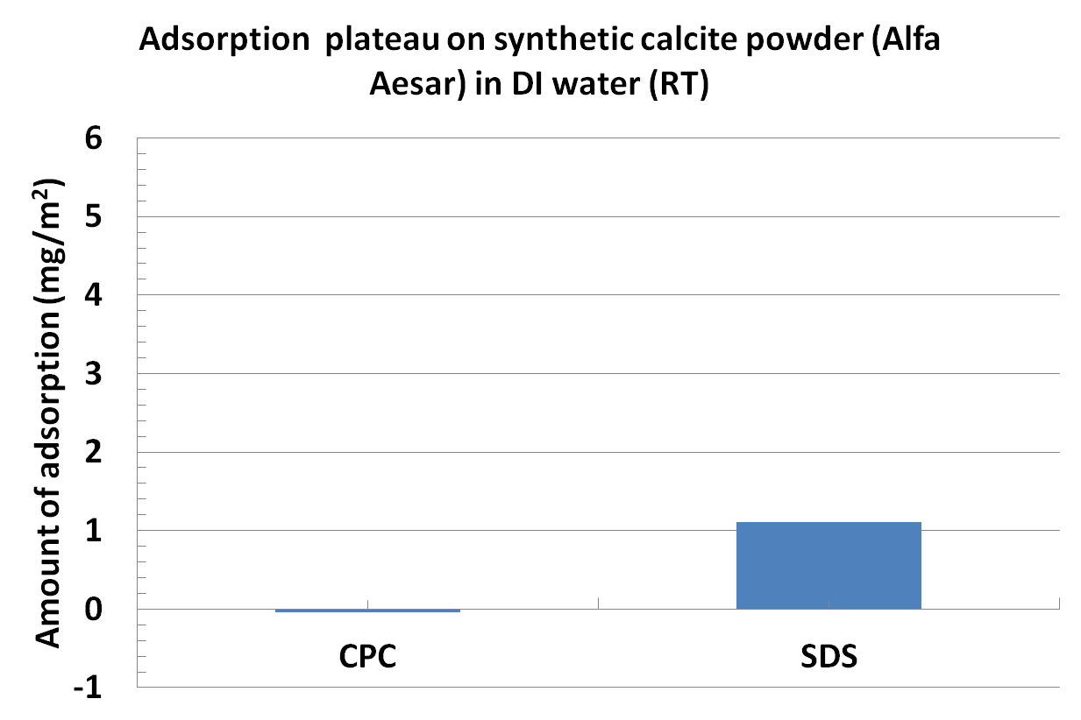
Adsorption on synthetic calcite

Slide 9
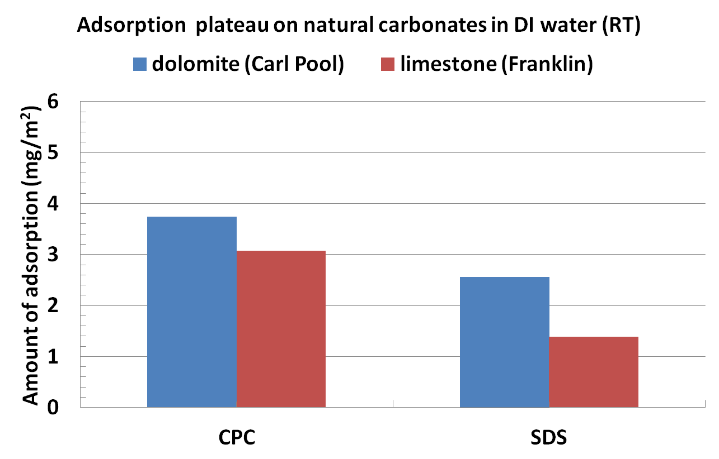
Adsorption on natural carbonates

Slide 10
Why is adsorption larger on limestone and dolomite compared to calcite?
Hypothesis: Natural limestone and dolomite contain silicate minerals that adsorb cationic surfactants
  Clays and chert (silica)
  Analyze with XPS and EDX

Slide 11
Analysis of surface chemistry (XPS)

Slide 12
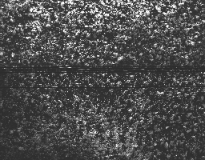

Distribution of Si on dolomite (EDX)
SEM image of dolomite powder (Carl Pool)
Red spots indicate silicon (1.35% by atomic composition)

Slide 13
Outline
Materials: Surfactants and Minerals
Adsorption on natural and synthetic minerals
Salinity influence on adsorption

Slide 14
Cloud Point of C12
1% C12 in DI Water
1% C12 in Brine (182.31g/L NaCl, 77.25 g/L CaCl₂·2H₂O 25.62 g/L MgCl₂∙6H₂O)
pH is adjusted by acetic acid

Slide 15
pH of Solution under 2 atm CO₂ and equilibrium with mineral
Simulated by Phreeqc software

Slide 16
Reduce Adsorption by adjusting salinity
(182.31g/L NaCl, 77.25 g/L CaCl₂·2H₂O 25.62 g/L MgCl₂∙6H₂O)

Slide 17
Reduce Adsorption by adjusting salinity
(Same Ionic Strength as in brine)

Slide 18
Cations Concentration during Adsorption Test on Silica
 | DI | Brine | NaCl | MgCl₂
Al³⁺ (mol/L) | 0 | 0 | 0 | 0
Ca²⁺ (mol/L) | 0 | 5.78E-01 | 0 | 0
Mg²⁺(mol/L) | 0 | 1.39E-01 | 0 | 1.695
Na⁺ (mol/L) | 0 | 0 | 4.91 | 0

Slide 19
Cations Concentration during Adsorption Test on Kaolin
 | DI | Brine | NaCl
Al³⁺ (mol/L) | 7.18E-05 | 5.20E-04 | 1.94E-04
Ca²⁺ (mol/L) | 0 | 5.77E-01 | 0
Mg²⁺(mol/L) | 0 | 1.39E-01 | 0
Na⁺ (mol/L) | 0 | 3.44 | 4.91

Slide 20
Cations Concentration during Adsorption Test on Dolomite
 | DI | Brine | NaCl | MgCl₂
Al³⁺ (mol/L) | 0 | 0 | 0 | 0
Ca²⁺ (mol/L) | 6.47E-03 | 5.64E-01 | 8.35E-03 | 9.88E-03
Mg²⁺(mol/L) | 6.53E-03 | 1.45E-01 | 9.36E-03 | 1.67
Na⁺ (mol/L) | 0 | 0 | 4.90 | 0

Slide 21
Analysis of surface chemistry (XPS)

Slide 22
Al³⁺ influence on adsorption on Silica
Test the adsorption on the mixture of silica and dolomite.
 | Kaolin+SiO2/Brine | Kaolin/Brine | SiO2/Brine
Al³⁺ (mol/L) | 5.71E-04 | 5.20E-04 | 0
Ca²⁺ (mol/L) | 5.77E-01 | 5.77E-01 | 5.78E-01
Mg²⁺(mol/L) | 1.39E-01 | 1.39E-01 | 1.39E-01
Na⁺ (mol/L) | 3.44 | 3.44 | 3.44

Slide 23
C12 Adsorption on Silica
The adsorption on silica is reduced to around half in the presence of only 5.74×10⁻⁴ mol/L Al³⁺.

Slide 24
Conclusions
Cationic surfactant has less adsorption than anionic on pure carbonate surface (synthetic calcite).
Cationic surfactants have larger adsorption on natural carbonate sands (dolomite and limestone), silica and kaolin.
The natural carbonate sands have substantial clays and/or silica.
The adsorption can be effectively reduced by trivalent ions (Al³⁺) and divalent ions (Ca²⁺).

Slide 25
Question?
Thank you!

Slide 26
Backup- activity
Dolomite | activity
 | DI | Brine | NaCl | MgCl2
Al3+ | 0 | 0 | 0 | 0
Ca2+ | 3.22E-03 | 4.86E-01 | 5.82E-03 | 7.17E-03
Mg2+ | 3.31E-03 | 2.32E-01 | 1.14E-02 | 2.153
Na+ | 0 | 4.598 | 5.92 | 0
Silica | activity
 | DI | Brine | NaCl | MgCl2
Al3+ | 0 | 0 | 0 | 0
Ca2+ | 0 | 4.99E-01 | 0 | 0
Mg2+ | 0 | 2.23E-01 | 0 | 2.189
Na+ | 0 | 4.60E+00 | 5.896 | 0

Slide 27
Backup-activity
Kaolin | activity
 | DI | Brine | NaCl
Al3+ | 5.69E-05 | 2.29E-05 | 8.73E-06
Ca2+ | 0 | 4.99E-01 | 0
Mg2+ | 0 | 2.23E-01 | 0
Na+ | 0 | 4.60E+00 | 5.90E+00
Kaolin+SiO2
 | Brine
Al3+ | 2.51E-05
Ca2+ | 4.99E-01
Mg2+ | 2.23E-01
Na+ | 4.60E+00

Slide 28
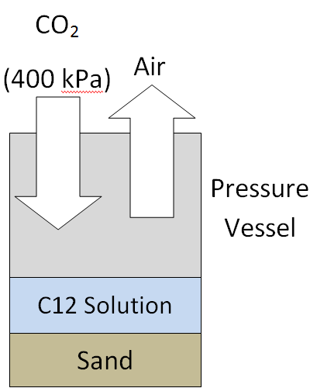


Static Adsorption Test under 2 atm CO₂

Slide 29
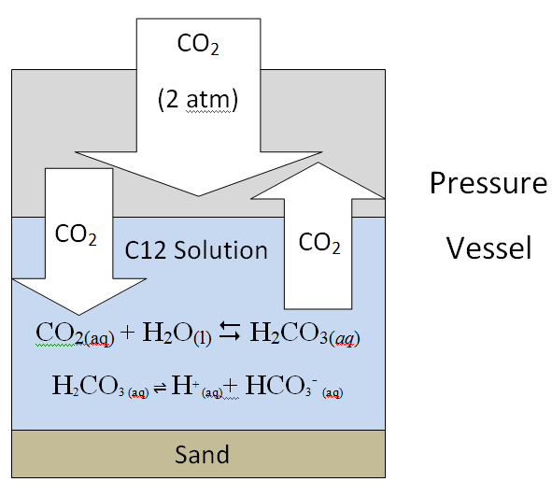
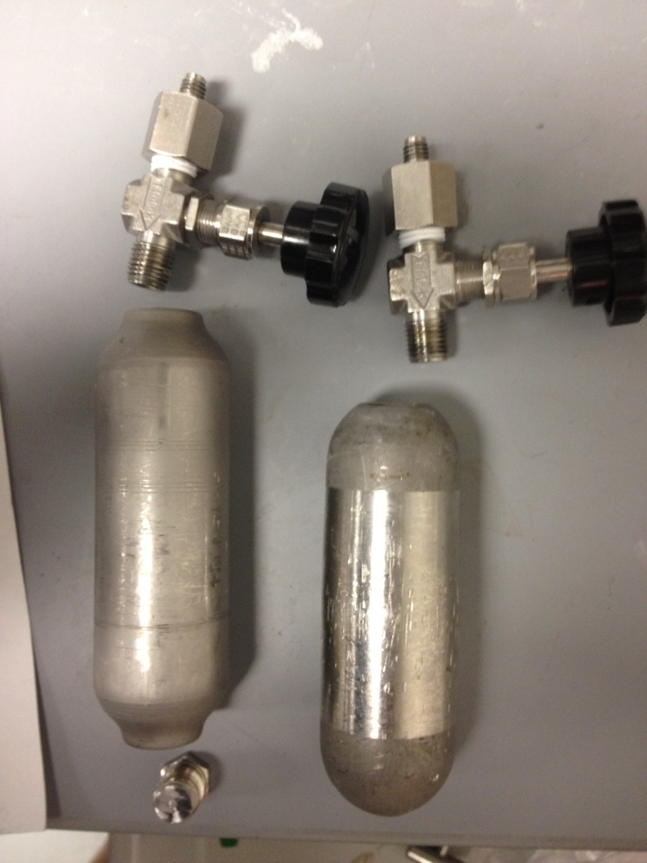
Static Adsorption Test under 2 atm CO₂
Pressure Vessel

Slide 30
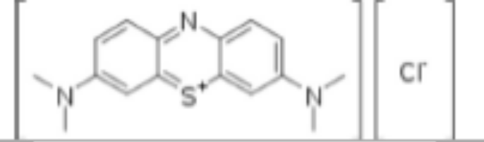

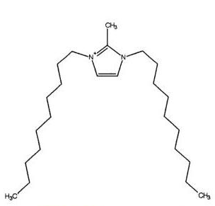
Chemicals in Two Phase Titration
MB solution: Methylene blue solution, which contains 0.03g/L (0.802mM) Methylene Blue, 50g/L Na₂SO₄, 6mL/L Sulfuric Acid (Fumic 20%). The methylene blue (MW= 373.9 g/mole) structure is shown beside:
SDES: Sodium dodecyl ether sulfate with 3 EO from Stepan. Trade name is STEOL CS 330, lot # is 0-15021. MW=422 g/mol.
TEGO: 1,3-Didecyl-2-methylimidazolium chloride from Fisher Scientific. The structure is shown beside:

Slide 31
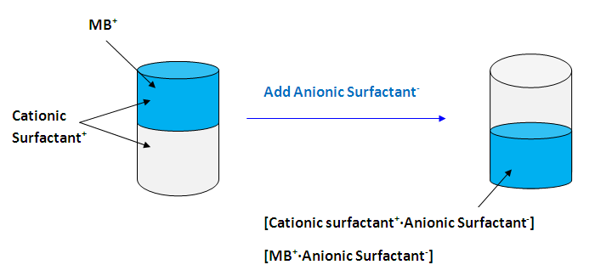

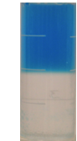
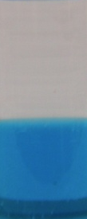
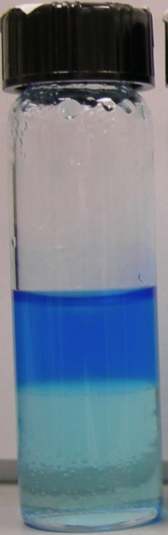
Colormetric Two Phase Titration

